Slide 1

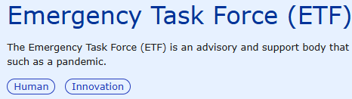

Update on EMA Emergency Task Force (ETF)
ACT-EU Multi-stakeholder platform advisory group
Manuela Mura
26 June 2025
Source: NIAID Image (unchanged) downloaded from File:Influenza Virus.jpg - Wikimedia Commons

Slide 2
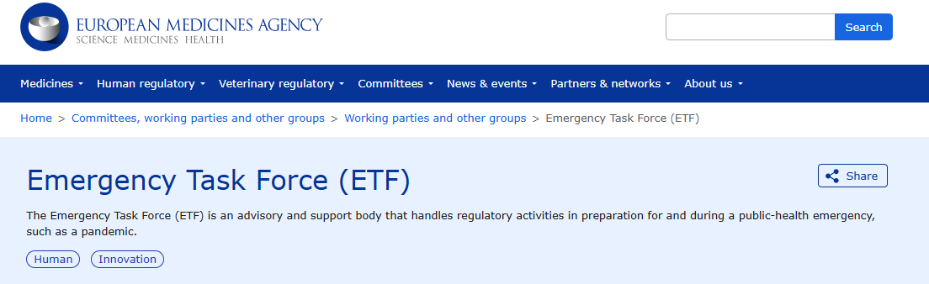
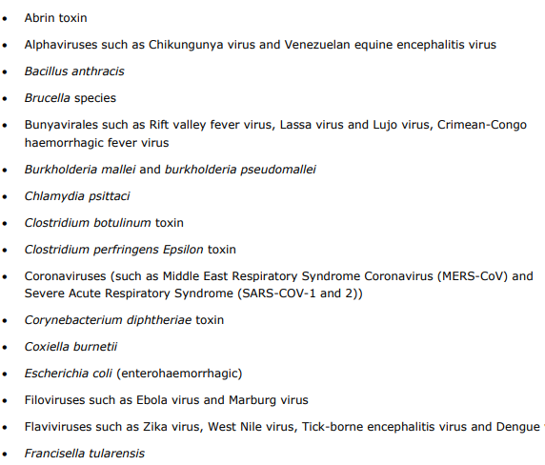
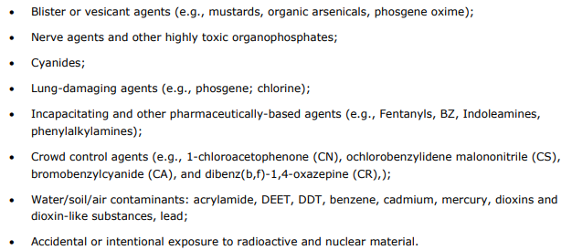
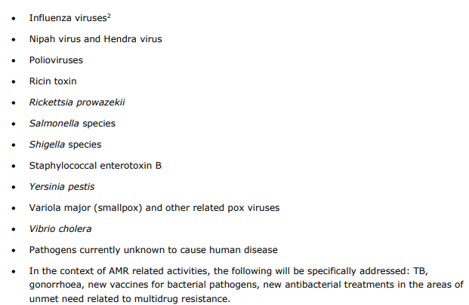
AMR related activities - focus on TB, gonorrhoea, new vaccines for bacterial pathogens and new antibacterial for unmet needs with MDR
Consolidated 3-year work plan for the Emergency Task Force (ETF)

Slide 3
EU initiatives on scientific advice procedures
SAWP-CTCG scientific advice pilot on clinical trials and on requirements for marketing authorisation applications (MAA)- coordinated by EMA under ACT-EU
Pre-CTA advice pilot to provide technical and regulatory support on the dossier of a CTA prior to its submission through CTIS – coordinated by CTCG under ACT-EU
https://www.ema.europa.eu/en/news/two-new-advice-pilots-improve-clinical-trials-europe
Simultaneous National Scientific Advice (SNSA) from national competent authorities (NCAs) – coordinated by the EU Innovation Network (EU-IN)
https://www.ema.europa.eu/en/committees/working-parties-other-groups/eu-innovation-network-eu
ETF-CTCG-EAG scientific advice on clinical trials and on requirements for marketing authorisation applications (MAA)- coordinated by EMA - NEW

Slide 4
EMA ETF scientific advice on medicines for emergency & prep
SAWP scientific advice
ETF scientific advice
Scientific advice submission
Declared emergency: SAs free of charge and accelerated (20 days) if on CTs
Preparedness: same TT as for SAWP
Scientific Advice Working Party (SAWP)
Emergency Task Force (ETF)
Clinical trial experts from National Competent Authorities
Harmonisation of advices across EU authorities to facilitate CTAs, product development and licensure
CHMP adoption
Applicant

Slide 5
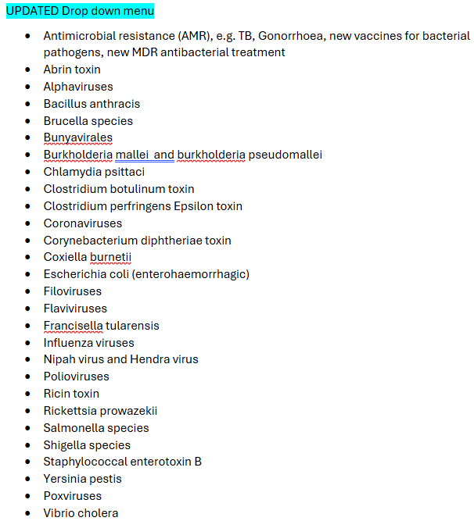
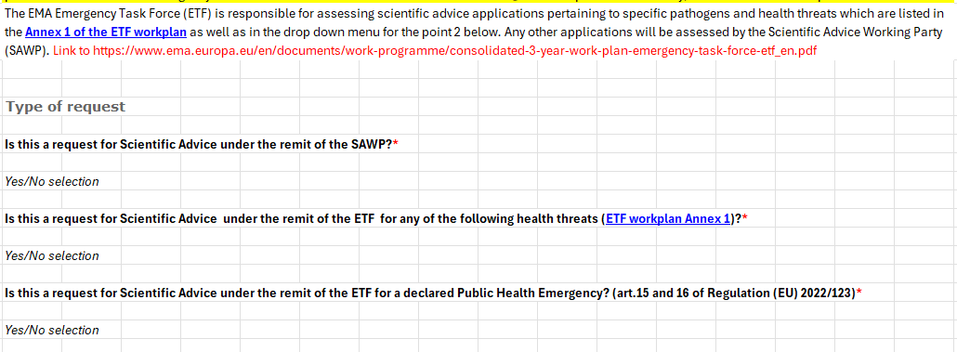
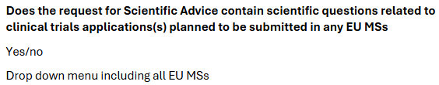
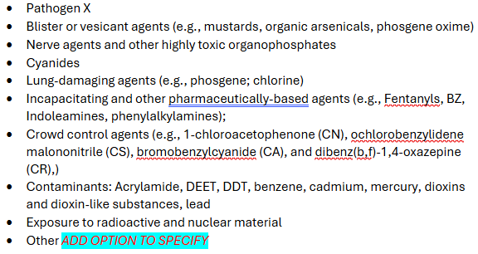
NEW IRIS application form for SA since April

Slide 6
New ETF SA can include questions on CTAs
Process similar to the SAWP/CTCG pilot in ACT-EU (consolidated pilots) – common lessons learned
Request for advice to the ETF will be evaluated by 2 coordinators
Trigger: applicants must tick the CTA box in the application form
Coordinators will be preferentially the proposed Reporting MS (RMS) and MS Concerned (MSCs)
The application will be assessed by the 2 coordinators together with the CT Unit in their MS
The views of the MSCs will be harmonized
Ethics experts from EU ethics committees will take part in the assessment
The Ethics Advisory Group (EAG) created under ACT-EU (public health emergency) includes so far 11 experts from different MSs
Applicant will receive one final advice letter from CHMP that contains advice on requirements for marketing authorisation (MA) as well as clinical trial authorization (CTA)

Slide 7


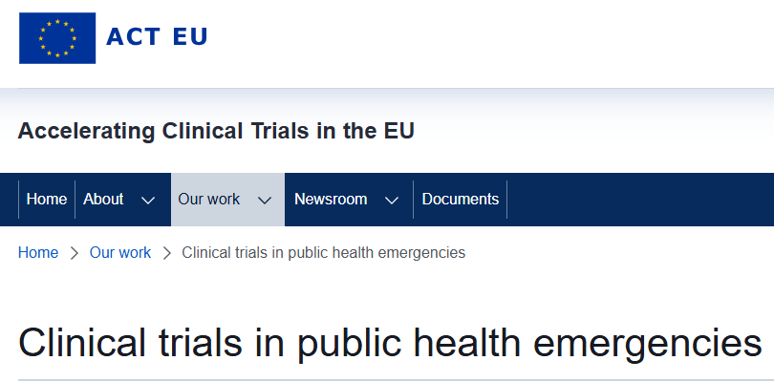
Take home messages
Since March 2025, ETF covers activities related to AMR, focus on TB, gonorrhoea, new vaccines for bacterial pathogens, new antibacterial treatments for unmet needs related to MDR
(PHEearlyinteractions@ema.europa.eu)
Since July 2025, ETF scientific advice covers for questions related to clinical trials authorisations
(scientificadvice@ema.europa.eu)
CT assessors (CTCG) and ethics assessors (EAG) are involved in the SA procedure and reply to specific questions, but advice not binding for CHMP or MSs (pending data assessment)
EAG views are personal view of ethics experts
Clinical trials in public health emergencies - European Union

Slide 8
Closing slide
Manuela.mura@ema.europa.eu

