Slide 1

Clinical trials in public health emergencies
MSP AG, 26 June 2025
Presented by Marco Cavaleri and Monique Al

Slide 2

Lessons learned workshop on clinicals in PHEs
Workshop in June 2023 – report
Framework for funding clinical trials during PHEs in the EU
Problems identified:
  Insufficient coordination and fragmentation of clinical trials during emergencies​
  ​Lack of consolidated mechanism for investigational products prioritisation​
  ​Lack of flexible funding mechanisms for larger, multinational trials: mobilisation of the necessary funds is slow and uncertain
Coordinating mechanism established under European Commission DG HERA (Health Emergency Preparedness and Response Authority) to focus on actions regarding development of a funding framework

Slide 3
Lessons learned workshop on clinicals in PHEs
Regulatory problems identified: ​
  Insufficient coordination within the MSs, between NCAs and ethics committees ​
  Slow clinical trial application assessment and authorization
  Insufficient coordination across MSs in the case of multinational trials, also due to national requirements that lead to dis-harmony​
  Lack of flexibility in CTR for the approval process​
  Functioning and knowledge of CTIS
ACT EU priority action established to focus on specific recommendations from the workshop that were not covered by others

Slide 4

Clinical trials in public health emergencies (PHEs)
Adopted by the ACT EU Steering Group end of June 2023, newest PA
Objective: To prepare the European clinical trials environment to implement an expedited, harmonized authorization procedure that allows for timely start, and flexible conduct of multi-national, impactful clinical trials during public health emergencies for rapid deployment of medical counter measures
Priority Action members: Commission (SANTE and RTD); CTCG; EMA; ethics committees, working closely with an academic reference group
Notes:
Out of the box proposals for exceptional circumstances

Slide 5
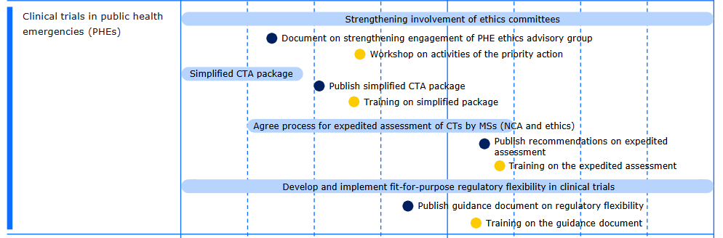
PA deliverables
Revise the dates

Slide 6
Strengthening the involvement and collaboration of ethics committees
Experts in clinical trials ethics with interest/experience in public health emergencies nominated through MedEthicsEU
PHE ethics advisory group (EAG) with 14 representatives from 11 Member States
Process for involvement of PHE EAG in ETF to provide ethical considerations in scientific advice procedures. PHE EAG expected to join ETF SA procedures on ethical aspects in Q3 2025.
Benefits and Learnings from the Scientific Advice procedures and collaboration with PHE EAG will be evaluated
Exploring the possibilities (pros/cons) of a European central ethics committee for the assessment of CT application in PHEs

Slide 7
Developing simplified packages for CTs in PHEs
CTR annexes analysed, analysis of templates ongoing
Survey on national language requirements in a PHE
Proposed simplifications for Part I and Part II documents under discussion in CTCG and MedEthicsEU
Aiming for endorsement and publication of set of documents at end of 2025
Notes:
Limit to those documents that are legally required (survey investigating what are the legally required)

Slide 8
Developing fit-for-purpose regulatory flexibility for CTs in PHEs
Guidance on the conduct of clinical trials during public health emergencies drafted and under review by the EMRN until end of August 2025
Public consultation planned in Q4 2025
Based on the HMA/EMA/EC COVID-19 guidance and taking into account other existing guidance/recommendation papers
Work on expedited assessment to start based on draft simplified CTA package
Draft procedure expected in Q1-Q2 2026

Slide 9

Joint workshop ETF – PA with PHE EAG
21-22 November 2024
Practical and policy aspects related to preparation and response to the EU clinical trials environment to a PHE
Report

