Slide 1
Patient involvement during life cycle of clinical trials
Successful implementation without legal enforcement?
Marianne Lunzer, AGES MEA
Multi-stakeholder platform Advisory Group meeting , 26 June 2025

Slide 2
CTCG project Patient Involvement
The CTCG is a working group of experts/regulators in the classification, assessment and oversight of clinical trials from National Medicine Agencies from 30 Member States in the EU/EEA.
The objective of CTCG is to contribute to increasing the attractiveness of the EU/EEA for clinical trials by harmonisation and optimisation of the regulatory environment while assuring the protection of rights, safety and wellbeing of the trial participants and the generation of robust data.
Patients should have early access to innovative treatments which will by a flexible regulatory environment for sponsors of innovative clinical trials. CTCG strongly supports interaction with all relevant stakeholders involved in clinical trials.
CTCG started this project to foster patient involvement in clinical trial design

Slide 3


Objective project
To foster patient involvement by meaningfull review of patient involvement in the design and conduct of clinical trial, including submission of the summary of results for laypersons by regulators and/or ethics committees
Phase I of the project
Focus on patient involvement in the design of the clinical trial

Slide 4
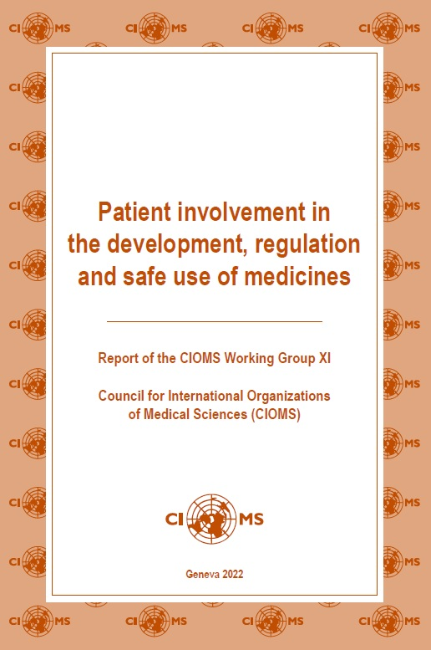
Patient involvement in clinical trial design
CTR, EU no 536/2014:
Annex I D 17(e): The protocol shall at least include: ... (e) where patients were involved in the design of the clinical trial, a description of their involvement.
Annex I D 24: The protocol shall be accompanied by a synopsis of the protocol. Q&A: “Sponsors should consider to make the synopsis understandable to a layperson”.
CTR art. 37.4: ... the sponsor shall submit to the EU database a summary of the results of the clinical trial ... accompanied by a summary written in a manner that is understandable to laypersons.
Declaration of Helsinki (2024)
“Meaningful engagement with potential and enrolled participants and their communities should occur before, during, and following medical research. Researchers should enable potential and enrolled participants and their communities to share their priorities and values; to participate in research design, implementation, and other relevant activities; and to engage in understanding and disseminating results.”
WHO Guidance for best practice for clinical trials (2024)
“Key message: Potential participants and/or members of the relevant
community provide valuable contributions to the design,
execution and interpretation of the results of clinical trials.”
CIOMS report (2022)

Slide 5
Preliminary analysis stakeholder sessions
All stakeholders consider patient involvement important but have different expectations regarding how it should be embedded in the regulatory system and who plays which role in it.
There seems to be some tension between the need for a clear guidance/framework and at the same time the need for more diversity and flexibility.
Risk for tokenism/‘tick box’ with no added value
Distinction between design and conduct should be considered
Local versus global impact
Concerns about the additional burden to report on patient involvement in all cases
Clarity needed on the regulator expectations

Slide 6
Reflection paper – timeline
Jun | Jul | Aug | Sep | Oct | Nov | Dec | Jan | Feb | Mar | Apr | May
Reflection paper activities
Drafting
Finalizing first draft
Second draft
Final review
Reflection paper
Stakeholder sessions
  Summer: drafting
  October: finalizing first draft
  November: stakeholder sessions to evaluate draft
  December/January: second draft
  February: final review

Slide 7


How can scientific and ethical review foster meaningful patient involvement in clinical trial design?
Which incentives would help?
Awarding excellence? Label?
Thank you for your attention!

