Slide 1
ACT EU Multi-stakeholder Platform Advisory Group meeting
26 June 2025
Pre-read materials

Slide 2
Table of contents
• ACT EU workplan
• Monitoring of the clinical trials environment
• CTR Collaborate
• COMBINE programme
• MedEthicsEU
• WHO Global action plan/resolution 75.8 activity
• Lancet series – Clinical Trials in Global Health 2025

Slide 3

ACT EU Workplan
ACT EU Multi-stakeholder Platform Advisory Group meeting
26 June 2025

Slide 4
ACT EU WORKPLAN
Progress on CTR implementation:
  Examples of problematic RFI being assessed with MSs
  Collection of most frequent RFI raised following consultation with the CTAG
  January- March KPI report published in April, 3 year-KPI report under development
  Revision of CTR/CTIS training material with new sponsor handbook (to be finalised in July)
Support to non commercial sponsors:
  1,500 tickets addressed with the Regulatory helpdesk
  Dedicated webinar to support academic networks in the MSs
  Methodologies:
  Workshop on Bayesian Statistics 17 June (hybrid)
  Workshop on clinical assessors 14 /15 July (EMRN* only) serve as the basis for the multistakeholder workshop to be organised with Enpr-EMA in Q4 2025/ Q1 2026
  Workshop on risk-based approaches under preparation, date TBC
  Roadmap collecting all CTCG/MWP guidance under development, is being finalised
  Best practice on guidance development is being finalised (for EMRN only)
  *EMRN: European Medicines Regulatory Network

Slide 5
ACT EU WORKPLAN
  Consolidated advice on clinical trials pilots, initiative ongoing:
  8 applications SAWP/CTCG
  14 pre-CTA
  Clinical Trials analytics:
  Trial Map communication expanded with initiatives at national level and in local languages to raise awareness on the map and increase findability of trial sites
  Paper on research priorities under development
  Training
  Training needs for academia and SME survey report soon to be published
  Next step > signposting of existing initiatives to increase findability of the information
  Deliver under ACT EU training on prioritised topics
  ICH E6 R3 training
  Extensive (online) training material being prepared at ICH level

Slide 6

Monitoring of the clinical trials environment
ACT EU Multi-stakeholder Platform Advisory Group meeting
26 June 2025

Slide 7
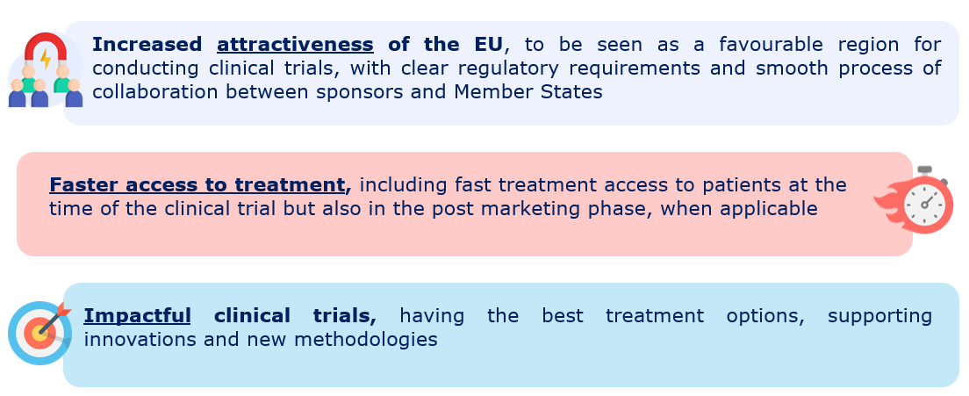
Benefits of an improved CT environment

Slide 8
KPI measured against targets
Key performance indicator for attractiveness:
Number of authorised multinational clinical trials in the EU
Key performance indicator for speed/time:
Time from submission of CTA to start of patient recruitment at the site of the first MSC (stratified by mono/multi-national trials)

Slide 9
Impactful clinical trials
Several rounds of consultation to define a metric that could be representative of impactfulness
Focusing on MAA not representative of academic dimension and only presenting partial perspective
MSP AG consulted on 12 March; feedback collected (deadline 26 March)
Points raised:
  Impact of results on clinical guidelines and publication on high impact medical journals;
  Submission of negative results also important for clinical research;
  Clinical trials in paediatric population;
  Innovation: CT with decentralised elements, complex clinical trials;
  Speed of recruitment/ proportion of recruited patients;
  ATMPs
Agreed that impactfulness will be a composition of parameters to measure, no targets
Some will be measured on regular basis as extracted from CTIS and other measured on periodic basis

Slide 10

Accessibility of the information and reporting
Public
Quarterly – KPIs and new metrics to complement the already existing KPI reports published on ACT EU website (new format)
Information on monitoring the clinical trial environment accessible from the ACT EU website with dedicated page

Slide 11
CTR Collaborate
Latest updates

Slide 12
CTR Collaborate Workshop – Overview
Date: 13 May 2025
Participants: 115+
Purpose: Fostering dialogue between National Competent Authorities (NCAs) and Ethics Committees (ECs)
Tracks focused on Annex I, consideration handling, and RMS role
Participants included assessors from NCAs, ECs, and European Commission representatives

Slide 13
Key Breakout Track Outcomes
Track 1: Categorized Annex I elements (mandatory, critical, non-critical)
Track 2: Drafted principles for not including or accepting considerations
Track 3: Explored EU/EEA alignment on optimal implementation of the Rapporteurs principle
All tracks emphasized the importance of clear guidance for EU/EEA harmonization

Slide 14
Key messages
Highlighted goals:
- Pragmatic application of CTR in daily practice
- Focus on critical considerations
- Different levels of details provided and/or expected in
the assessment report to be aligned across the MSs
Next steps:
- Finalise outputs
- Align policy across MSs by optimized implementation of Best Practice

Slide 15



COMBINE programme
+
Update for ACT EU MSP
28 May 2025
Ditte Zerlang Andersen, PhD, Danish Medicines Agency (DKMA), COMBINE Programme Manager

Slide 16

‘COMBINE’ programme kick-off Dec 2024
The COMBINE programme seeks to make the European Union an attractive region to conduct combined studies, envisioning a clear and smoothly functioning regulatory environment for combined studies through broad involvement of regulators, ethics committees and all impacted stakeholders, with the ultimate goal to support availability of innovative treatments for patients.
If you want to go fast, go alone If you want to go far, go together
Analysis report and programme strategy at Website: Combined studies - European Commission ₂

Slide 17

EU Groups involved
+
Broad framework for collaboration across EU landscape:
Commission and EU Expert groups of national competent authorities
Clinical trials of
Medical devices
Ethics
medicines
Medical Device Coordination Group (MDCG)
MedEthics EU - Voluntary coordination
Clinical Trials Advisory Group
(CTAG)
between national ethics committees
2 of its 13 subgroups: IVD and CIEPSE
Clinical Trials Coordination Group (CTCG)
3

Slide 18

Stakeholder reference group
ACRO (Association of Clinical Research Organizations) AMDM (Association of Medical Diagnostics Manufacturers) Biomedical Alliance in Europe
COCIR
Conect4Children Stichting
EAN (European Academy of Neurology)
EATRIS (European Infrastructure for Translational Medicine) ECRIN (European Clinical Research Infrastructure Network )
EUCOPE (European Confederation of Pharmaceutical Entrepreneurs)
EuropaBio
EAAR (European Association of Authorised Representatives)
EFPIA (European Federation of Pharmaceutical Industries and Associations) EHA (European Hematology Association)
EORTC (European Organisation for Research and Treatment of Cancer)
ESMO (European Society for Medical Oncology)
MedTech Europe MPP Association
NBCG-Med (Notified Body Coordination Group)
TEAM-NB (European Association of Medical Devices Notified Bodies) VE (Vaccines Europe)
4

Slide 19
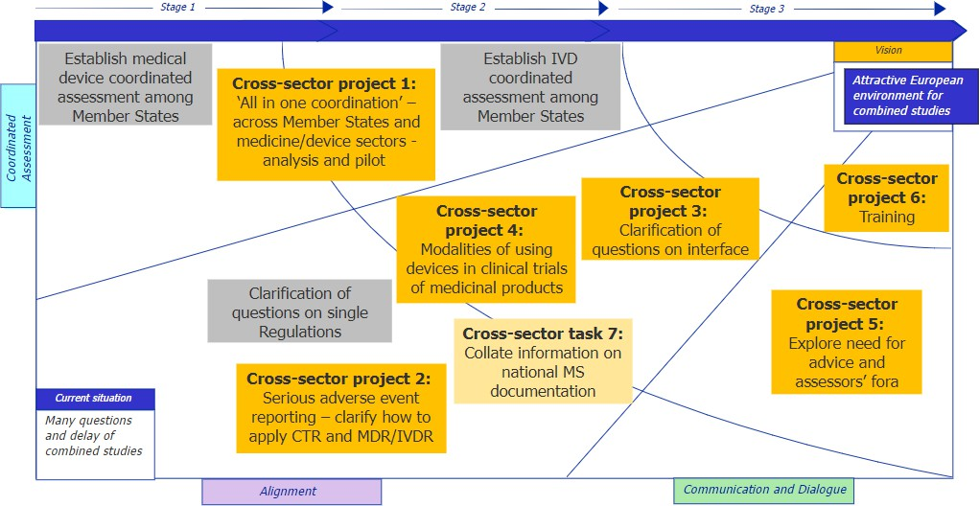
Transformation diagram of projects
Dec
Apr
Jan
Q3
Feb
5

Slide 20
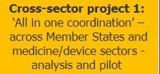















Project 1: ‘All in one coordination of assessment procedures under CTR/IVDR/MDR’
Purpose: Explore coordinating Member State assessments of applications for combined studies (CA/EC) across the CTR and IVDR or MDR using a CT of a medicinal product combined with PS of a companion diagnostic IVD as case example
Deliverables
Analyse possibilities for voluntary multi-Member State CT/PS single coordinated assessment procedure
Leads: Claire Temple and Philip Kelly (IE), Marianne Lunzer (AT), Monique Al (NL)
Project 1 Participants
Outline a single pilot procedure
2%
CTIS
CTR
CTR/Ethics
Ethics IVD MD/IVD
23%
43%
Establish the pilot
14%
Run the pilot
16% 2%
Evaluate the results
14 MS + EMA
45+ participants,
Initiated Dec 2024
6

Slide 21




Pilot Key Features
Single submission in CTIS consisting of a parallel submission of:
Coordinated RFI for CT and PS
Coordinated response from sponsor to the RFI
Goal: To have information/ changes to documentation occurring at the same time
Alignment of decisions
CT documentation
PS documentation
EC documentation for the CT EC documentation for the PS.
Goal: To have questions raised together
Goal: Decisions/ opinions provided together
7

Slide 22
Phased Approach
Adapt process based on learnings
Phase 1
Review
Phase X
Review
Conduct a Pilot review and adapt next phase accordingly
Conduct a Pilot review and adapt next phase accordingly
Initial Pilot Feasibility
Limited number of
applications
Keep it simple:
  Single sponsor
  Part I and II application
  No ATMPs
Introduce any required changes
Explore integrating
more complexity
8

Slide 23
Sponsor Guide v1
Eligibility Criteria
Participating MS's
RMS Options
Pre-submission process
Procedure timelines
Documentation
Location
National
requirements
National PS submission (Day 69)
Decision
Information
Feedback methods
Updated as needed
9

Slide 24







Working timelines
Project team
Training/Best practice Preparation & pre-screening
Feb.–Apr.
Finalise work on tracks Establish pilot review metrics Stakeholder meeting Prepare sponsor overview
May 2025
Present latest information
June 2025
Launch call for interest
Stakeholders begin preparation
Sep. 2025
Pilot PHASE 1:
Planning first submissions
Expert Groups
Stakeholders
Preparation
10

Slide 25

Project 1 – most recent information
Pilot outline endorsed by the COMBINE governance
Sponsor webinar planned Jun 20th: Save the date post on LinkedIn
Following the COMBINE programme analysis report, the COMBINE PILOT on coordinated assessment is being launched. This initiative aims to streamline the review process for multinational clinical trials with a simultaneous performance study by synchronizing competent authority and ethics committee reviews.
🔑 Key Details:
Learn about the pilot for the ‘All-in-One' procedure
Pilot Sponsor Guide will be published in June 2025
Call for expression of interest will be published in June 2025
Webinar on 20 June, 14:00-16:00 CEST – perfect for potential sponsors. Tune in here 👇
https://lnkd.in/eR_9bcRc
Call for interest of application expected around Jun 13th – at COMBINE webpage
11

Slide 26


Project 2: ‘Serious adverse event reporting across CTR/IVDR/MDR’
Purpose: to clarify how to apply the CTR, MDR and IVDR requirements on serious adverse event reporting in combined studies.
Leads: Annemie Zenner (BE), Corina Spreitzer
and Marianne Lunzer (AT)
Comparison of safety recording and reporting procedures under each legal framework.
Project 2 Participants
1
3
Understand practical experience and challenges from stakeholders
3
5
Suggestion for solution of identified issues e.g. guidance document
Ethics CTR MD/IVD EMA
7 MS + EMA,
12 participants
Initiated Feb 2025
12

Slide 27

Project 4: ‘Modalities of using devices in clinical trials of medicinal products’
Cross-sector project 4:
Modalities of using devices in clinical trials of medicinal products
Purpose: to explore different modalities of using medical devices and IVDs in clinical trials of
medicinal products, in order to clarify applicable regulatory context for those devices and IVDs.
Leads: Stina Löfling (SE), Diego ALMEDA
Deliverables
A set of scenarios for using and/or investigating medical devices and IVDs in clinical trials of medicinal products
(FR) and Hilke Zander (DE, PEI)
Project 4 Participants
1
2
5
4
Clarify the regulatory framework for
each scenario
5
4
1
4
Guidance document (new/update) or similar tool to clarify the regulatory context as needed.
MD
CTR
IVD
CDx
MD/IVD
EC
Ethics
EMA
12 MS + EC + EMA
26 participants
Initiated Apr 2025
13

Slide 28
Project 2 and 4 – most recent information
Both projects are in analysis phase scoping work together with the stakeholder group.
5 stakeholder group meetings in May/Jun to scope work with stakeholders.
Work on solutions will involve the COMBINE stakeholder group in Q3.
More information:
Combined studies - European Commission (europa.eu)
14

Slide 29



MedEthicsEU
Group of national representatives of medical research ethics committees (MRECs)
Monique Al, Special Advisor, CCMO, Netherlands
Co-Chair MedEthicsEU
MSP AG meeting, 26 June 2025

Slide 30
MedEthicsEU
Special group of the European Commission DG-Sante
Representatives of national medical research ethics committees (MREC) in EU/EEA – nominated by national contact points of CTAG
    list national contact points: da8d6018-ed1c-4847-b17f-a67b8ecd521a_en (europa.eu)
MRECs involved in the assessment of clinical trials falling under the scope of the clinical trial regulation (CTR, EU no 536/2014), clinical investigations falling under the scope of the medical device regulation (MDR, EU no 2017/745) and/or performance studies falling under the scope of the in-vitro diagnostics regulation (IVDR, EU no 2017/746)
Participants from 26 member states in EU/EEA (mix of staff and committee members)
Pending/not participating: CZ, IS, LI (follows Suis legislation), MT

Slide 31





A network to strengthen the cooperation, exchange experiences, setting up best
practices and integrate ethics in the European Regulatory Framework
Delegates of the Ethics Committee system in Member States
MedEthicsEU
Coordinated EU voice
Different Ethics Committee systems in Member States
European Medicinal/ Medical Device Regulatory Network
MS National contact
point at NCA
National voice

Slide 32
How can MedEthicsEU help?
Participation in CTR collaborate project (CTCG initiative anchored in ACT EU) to strengthen collaboration between NCA and MRECs
Participation in COMBINE project – second phase (single procedure combined studies)
Exchange on the role of MRECs in the voluntary coordinated assessment of multinational clinical investigations (MDR) and clinical performance studies (IVDR)
Publish deliverables (e.g. on transitional trials, unexpected change of principal investigator, format recruitment material of audio/video material, transparency list of members MREC)
Working group on best practices – collaboration with CTCG best practice subgroup on the drafting of considerations
Part II templates: first revision started on template informed consent and patient recruitment
Align part II requirements per MS– first step: transparency on the part II requirements per MS (overview part II requirements of 21 MS on MedEthicsEU webpage: MedEthicsEU - European Commission
Survey on the translation aspects (documents and RFI)

Slide 33

Workplan MedEthicsEU 2025-2026
  Describes the planned actions/initiatives of MedEthicsEU for the period 2025-2026
Topics prioritized by the members of MedEthicsEU for 2025-2026 and ongoing activities of MedEthicsEU
Five main categories:
                Harmonisation on requirements part II dossier
                Harmonisation on operational procedures
                Coordinated procedures across regulations (CTR, MDR, IVDR)
                Review of ethical aspects
                Collaboration within the EU regulatory network
Annually review to allow for flexibility and to adapt to the current situation of the member states
Endorsed and (to be) published on MedEthicsEU webpage: MedEthicsEU - European Commission

Slide 34

WHO Global action plan/resolution 75.8 activity
ACT EU Multi-stakeholder Platform Advisory Group meeting
26 June 2025

Slide 35
WHO Global action plan/resolution 75.8 activity
For more information, please consult links below:
Strengthening clinical trials
Strengthening clinical trials to provide high-quality evidence on health interventions and to improve research quality and coordination
Guidance for best practices for clinical trials
Global action plan for clinical trial ecosystem strengthening
Global Clinical Trials Forum

Slide 36

Lancet series – Clinical Trials in Global Health 2025
ACT EU Multi-stakeholder Platform Advisory Group meeting
26 June 2025

Slide 37
Lancet series – Clinical Trials in Global Health 2025
For more information, please consult link below:
Clinical Trials in Global Health 2025

