Slide 1
Low-intervention clinical trials/ flexible safety reporting
Tarec Christoffer El-Galaly, Professor, MD, DMSc
Aarhus University Hospital and Aarhus University
MSP member for European Hematology Association (EHA)

Slide 2

Flexible safety reporting
Low-intervention CT

Slide 3
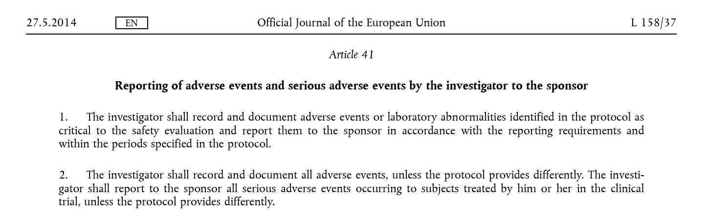
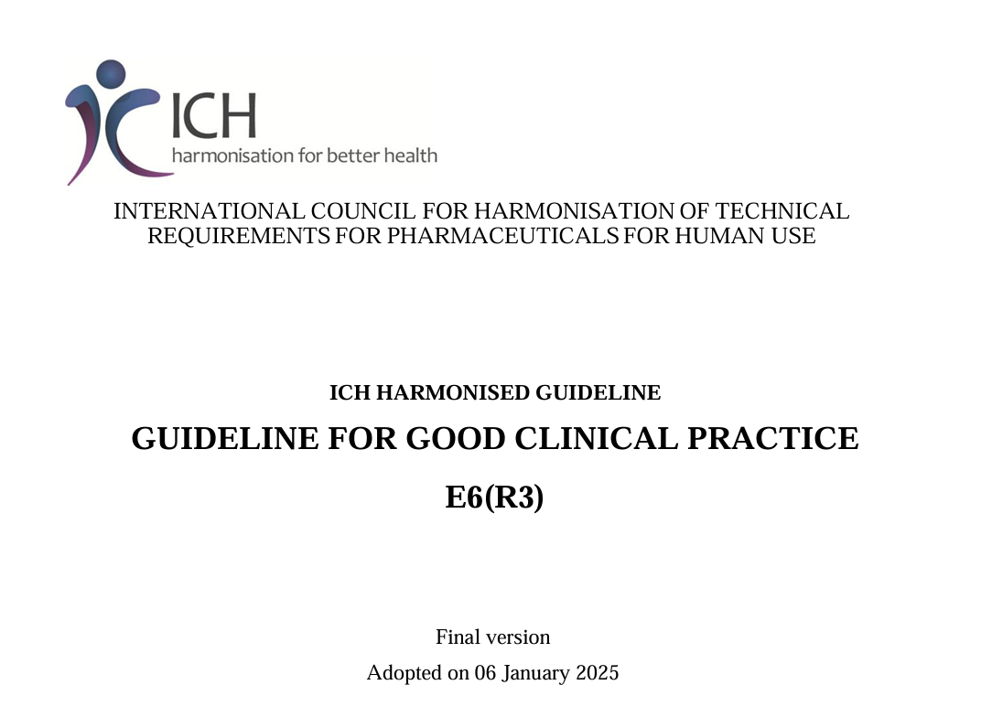
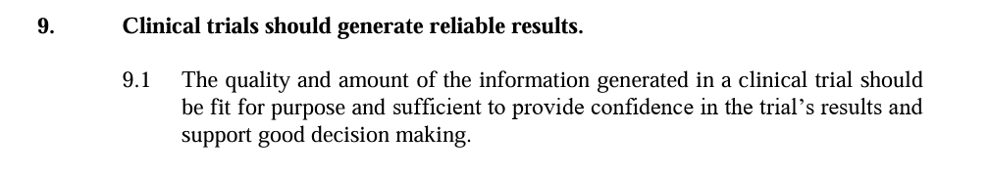
CTR is no barrier to flexible safety reporting
CTR already opens for flexible safety reporting in current wording
ICH: Good clinical practice to collect fit for purpose data – not too little, not too much
Solution: Harmonized EU implementation of CTR
Advertise and explain investigators how/when

Slide 4
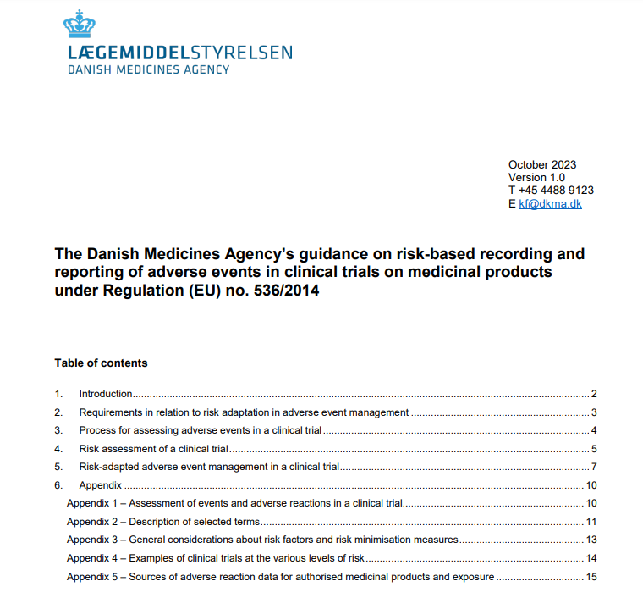
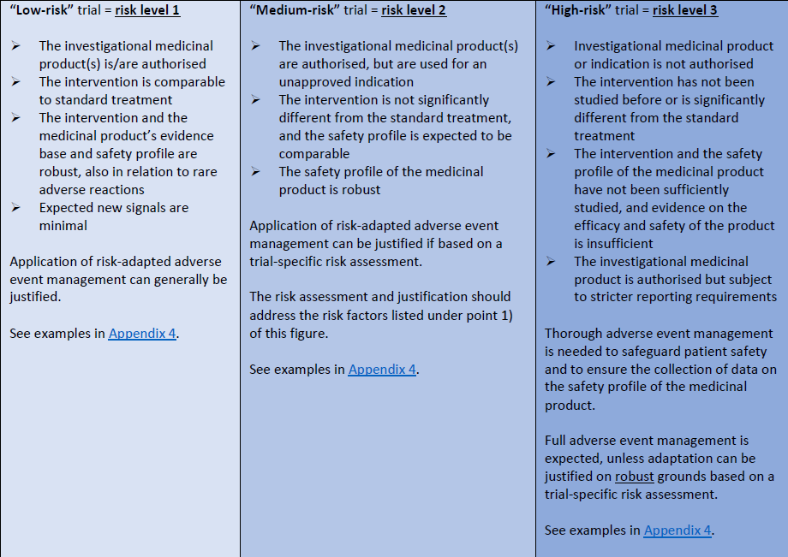
Example of guidance in use for flexible safety reporting
Primary target group is non-commercial sponsors investigating well-established authorized medicinal products
Risk level 1:
Authorized IMP in an approved indication or well-established off-label indication
Risk level 2:
  Authorized IMP in an unapproved indication which is similar to the authorized indication or normal clinical practice, and same safety profile.
  Risk level 3:
  Non-authorized IMP or authorized IMP in an unapproved indication
Risk level 1:
Only SUSARs will be recorded and expedited reported to the sponsor.
  Risk level 2:
  All SAE/SARs must be recorded, unless the protocol include a predefined list of exemptions.
  All recorded SARs must be expedited reported to the sponsor.
  Risk level 3:
All AEs/SAEs are recorded, and all SAEs/SARs are expedited reported to the sponsor.
Reduced AE management usually not possible at risk level 3
Risk-based approach acceptable

Slide 5

Reduced costs of clinical trials
Reduced work-load for investigators/nurses
Better reporting of clinical safety issues
More evidence/better treatments -> At a minimum risk

Slide 6
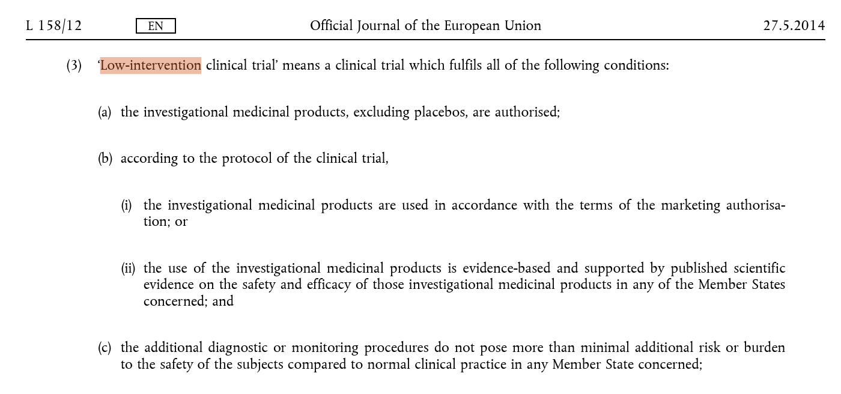
Low-intervention clinical trials (LICT)
The Sponsor can apply for LICT status based on these conditions
If LICT, fewer requirements for labelling, traceability and reduced monitoring
Less time spent on documentation
Reduced costs (monitoring)

Slide 7



Broader use of LICT
Assessment of LICT status requires clinical expertise
How well documented is the use of the IMP when not used for an approved indication
What are normal practices for diagnostic/monitoring and what defines “minimal” risk
All this can be done today, but requires guidance to harmonize interpretation of CTR
Decisions about LICT status requires flexibility
“Minimal risk” should be relative to risks that patients face during normal clinical practice
  A liver biopsy may be acceptable in cancer but not in migraine headache
Additional scans in a cancer trial should not necessarily preclude LICT
LICT status should be associated with more advantages to promote integration of clinical research in daily practice:
Reduced labelling, less monitoring – OK!
Why not as a rule reduce safety monitoring?

Slide 8
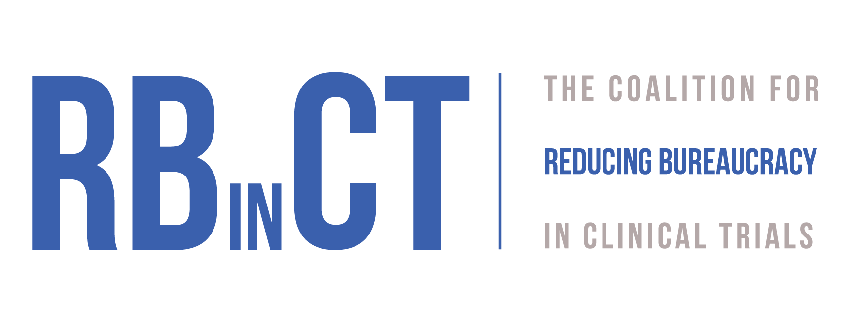
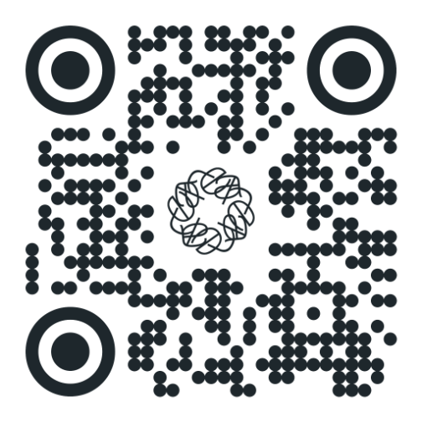
Reducing Bureaucracy in Clinical Trials (RBinCT)
Coalition Recommendations on Low-Intervention Clinical Trials - Classification:
The assessment of minimal burden should be based on routine procedures typically used for the specific disease and its treatment.
In cases of disagreement between the applicant and the authority evaluating the Clinical Trial Application (CTA), medical societies—composed of disease-specific experts—should be consulted.
Coalition Recommendations on Low-Intervention Clinical Trials – Safety reporting:
Only serious unexpected suspected adverse reactions (SUSARs) should be reported immediately
Serious adverse events (SAEs) should be reported on an annual basis
Non-serious adverse events should be reported only if of special interest or directly related to the study objectives

Slide 9
Conclusion
Building on the Danish example, all EU Member States should agree on a single risk-adapted approach to safety reporting, as already supported by the CTR
Acceptance of LICT status must be determined on a case-by-case basis – sometimes requires specialist knowledge (more studies should be LICT)
LICTs should be associated with more advantages for sponsors – for example reduced safety monitoring as a rule

