Slide 1

Update on policy development at the EU level
ACT EU Multi Stakeholder Platform meeting , 26 June 2025
Edit Szepessy, DG Health and Food Safety
Romina Escobar, DG Research and Innovation

Slide 2
Continuing support for clinical research through EU programmes
Horizon Europe funding – dedicated topics in the work programme, currently several open topics, for example on testing efficacy of phage therapy in difficult to treat infections
Bottom-up schemes: ERC, EIC, fellowships
Horizon Europe European partnerships: ERDERA, ERA4Health
Joint Undertakings: e.g. Global Health EDCTP3 – international partnership
Health research infrastructures BBMRI, EATRIS and ECRIN collaborating in EU-AMRI
Internal collaborations GACD (chronic diseases) and GloPID-R (preparedness)
EU4Health programme – e.g. projects supporting ACT EU activities or DG HERA supporting clinical development of the MTB-Vac tuberculosis vaccine
Notes:
The “pharma package” under consideration by the co-legislators foresees regulatory sandboxes to facilitate the development of complex products including so-called ATMPs

Slide 3
Overall funding for projects containing clinical research under Horizon 2020 and Horizon Europe*
 |  | Societal challenge Health/ Cluster Health | Of which IHI2 | Of which Global Health EDCTP3 | Excellent science (ERC) | Innovative science (EIC) | Overall
Horizon 2020 | Number of projects | 226 | 18 | N/R | 0 | N/R | 226
 | Funding (m EURO) | 1,810 | 430 | N/R | 0 | N/R | 1,810
Horizon Europe | Number of projects | 170 | N/R | 50 | 36 | 225 | 433**
 | Funding (m EURO) | 1,247 | N/R | 244 | 43 | 618 | 1,910**
*Analysis based on key word search in project data base and classification of projects; not all funding will go to clinical research activities: e.g. project may support getting an intervention ready to start clinical trials and funding early clinical testing. Horizon 2020 (running from 2014 through 2020) is concluded, there are more projects to come under Horizon Europe (2021-2027). Not shown in the table, the EU4Health programme also invests in some clinical research, e.g. supporting MTBVac clinical development
**There are also two small projects funded under the “Widening” section of Horizon Europe
Notes:
The “pharma package” under consideration by the co-legislators foresees regulatory sandboxes to facilitate the development of complex products including so-called ATMPs

Slide 4
Policy framework/outlook
Importance of clinical research highlighted in the ‘Letta report’ on future single market and the ‘Draghi report’ on competitiveness
Relevant activities announced in the Biotechnology and Biomanufacturing Communication of 20 March 2024 (COM(2024)137)
The new European Commission is working on an ambitious programme to strengthen European competitiveness; relevant work i.a.:
  Start-up and Scale-up Strategy – Adopted on 28 May 2025
  Life Sciences Strategy (expected early summer 2025) amongst other items is expected to address strengthening clinical research
  Research and Technology Infrastructures Strategy – Q3 2025
  AI in science Strategy – Q3 2025
  Bioeconomy Strategy – Q4 2025
  Biotech Act – 2026

Slide 5
European Life Sciences Strategy
Mentioned in the political guidelines of the Commission President
Task given to Commissioner Zaharieva in her mission letter
Call for evidence to collect input was open March/April period
Adoption expected before the summer break

Slide 6
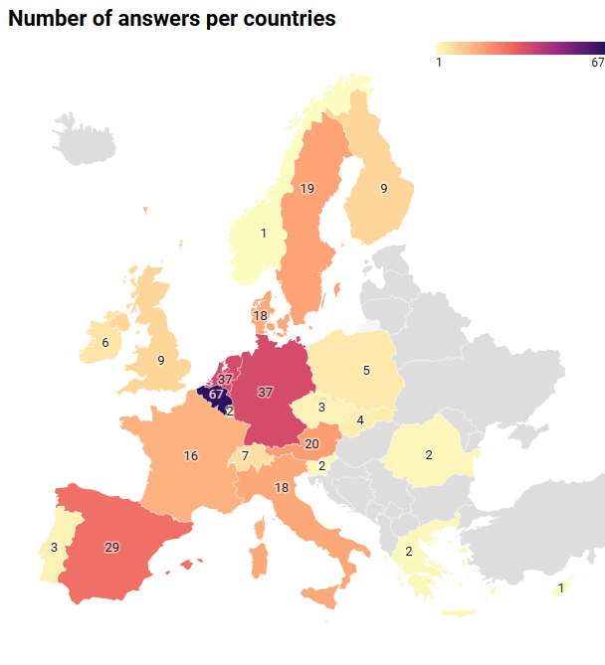
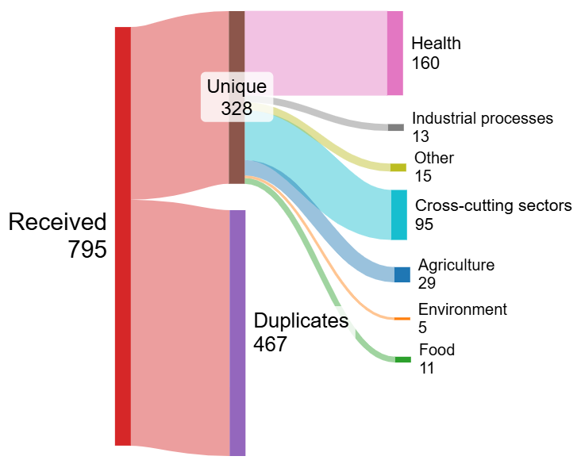
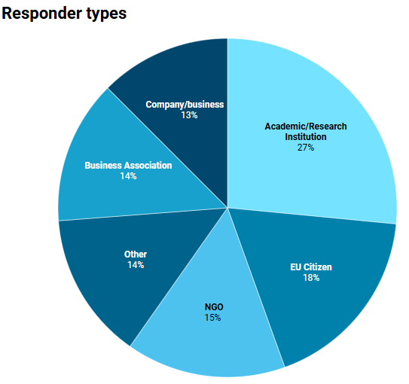
Call for Evidence analysis
Duplicates are ignored for the rest of the analysis
Top 5 topics mentioned:
R&I ecosystem
Complex regulatory frameworks
Investments and funding
Leveraging Science and Innovation
Data and AI
Top 5 countries:
Belgium (67)
Germany (37)
Netherlands (37)
Spain (29)
Austria (20)

Slide 7
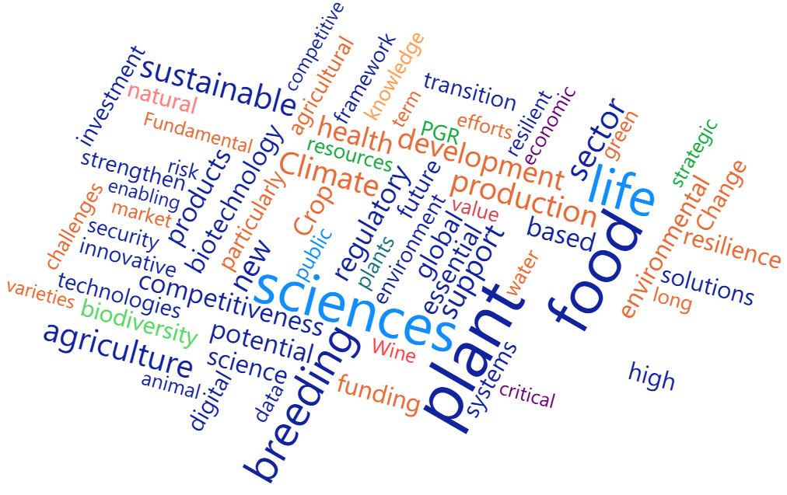
Top recommendations – Agri/Food/Env
Circular economy and resource efficiency:
  Prioritising the development of circular systems by upcycling side streams and valorising agricultural waste for the development of bio-based solutions.
Controlled environment agriculture:
  Investing in controlled environment production (vertical farming, biomanufacturing, hydroponics) for food security and resilience in the face of climate change.
Agriculture innovation at the root of food systems:
  Promoting new technologies like AI, precision agriculture, new breeding techniques and remote sensing to optimise agriculture.
Biodiversity as a foundation for innovation:
  Recognising biodiversity as a crucial element for innovation in life sciences - biodiversity and taxonomy should be central to EU innovation policy.
Adoption of alternative proteins and sustainable food sources:
  Supporting R&D in alternative proteins and sustainable food production methods (plant-based and microbial proteins, cellular agriculture...) to diversify food sources and contribute to food security and environmental sustainability.
Word cloud of the free text accompanying input labelled by reviewers of the CfE as agri, food or environment.

Slide 8
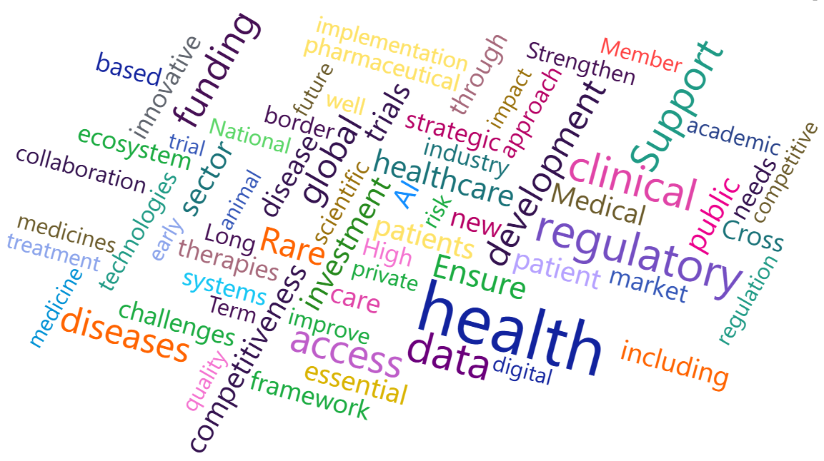
Top recommendations – Health
Promotion of New Approach Methodologies (NAMs):
  Advancing non-animal research methodologies for their ethical and predictive value in biomedical research.
Enhancement of clinical trials:
  Streamlining and optimising clinical trial processes, including regulatory simplification and digital integration to maintain our competitiveness.
Advancement of Advanced Therapy Medicinal Products (ATMPs):
  Supporting the development and integration of ATMPs such as gene and cell therapies, by addressing regulatory and sustainability challenges.
Focus on rare diseases:
  Prioritising rare diseases: improve research, diagnosis and treatment, leveraging cross-border collaborations and dedicated funding.
Crisis preparedness and supply chain resilience:
  Strengthening strategies for crisis preparedness and ensuring resilient supply chains to maintain the availability of essential health supplies.
Word cloud of the free text accompanying input labelled by reviewers of the CfE as "health" .

Slide 9
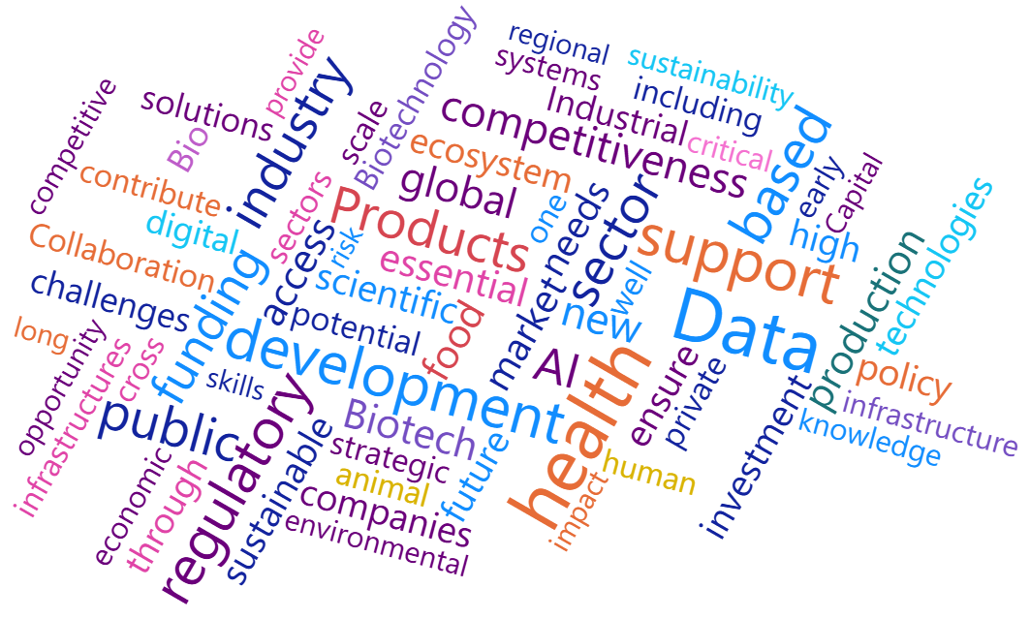
Top recommendations – Horizontal 1/2
Coherent policy framework:
  A better cohesion in life sciences policy governance at EU level and conducive regulatory environment.
Development of Biotech Hubs and Centres of Excellence:
  Strong emphasis on establishing and supporting biotech hubs and centres of excellence across Europe.
Integration of the One Health approach:
  One Health approach to address complex challenges and facilitate cross-sectoral collaboration and innovation.
Public-Private Partnerships (PPPs) and collaborative frameworks:
  Strong emphasis on developing and enhancing PPPs for pooling resources, sharing risks, and accelerating the translation of research.
Word cloud of the free text accompanying input labelled by reviewers of the CfE as cross-sectoral.

Slide 10
Top recommendations – Horizontal 2/2
Data and AI:
  Supporting data access, interoperability, and robust digital infrastructures, notably to support AI uses. Importance of data privacy/GDPR compliance as an asset for Europe and need to develop AI around it.
Attracting and retaining talent:
  Building a skilled workforce, with a focus on improving STEM education, world-class fellowships, and opportunities for life-long learning.
Venture Capital and funding mechanisms:
  Enhancing access to venture capital and developing funding mechanisms, especially for start-ups and SMEs. Creating incentives for private investment or the creation of market opportunities through IPCEIs
Word cloud of the free text accompanying input labelled by reviewers of the CfE as cross-sectoral.

Slide 11
Commission proposal for a European Biotech Act
Objective: to support the transition of biotech products from laboratory to factory and to the market
Areas for the impact assessment: simplification and streamlining to shorten ‘time-to-market’ for innovation, financing, scale, skills, use of AI
(Indicative) timelines, next steps:
►14 May- 13 June 2025
Call for evidence: over 240 contributions, under assessment
►Regulatory study: ongoing
►Public consultation: planned

Slide 12
Pharma revision provisions with relevance to clinical trials (based on Council proposed mandate, in negotiation between colegislators)
Streamlined GMO assessment for clinical trials to reduce complexity and expedite procedures as part of the environmental risk assessment;
Enhanced EMA regulatory support to academia and SMEs.
Decentralised manufacturing for certain IMPs (e.g. short shelf-life biological medicines or autologous ATMPs) allows production sites near patients
Modulation for regulatory market protection in case the MAA contains data (1) from multinational EU clinical trials (2) from clinical trials with relevant and evidence-based comparator and (3) in case of early regulatory submission
(Indicative) timelines, next steps:
►Commission proposal adoption: April 2023
►EP mandate: April 2024
►Council mandate: June 2025
► First political trilogue between colegislators: June 2025

Slide 13








Keep in touch
commission.europa.eu/
europeancommission
europa.eu/
@EuropeanCommission
@EU_Commission
EUTube
@EuropeanCommission
EU Spotify
European Commission
Notes:
Delete/update as appropriate

Slide 14

Thank you
© European Union 2023
Unless otherwise noted the reuse of this presentation is authorised under the CC BY 4.0 license. For any use or reproduction of elements that are not owned by the EU, permission may need to be sought directly from the respective right holders.
Slide xx: element concerned, source: e.g. Fotolia.com; Slide xx: element concerned, source: e.g. iStock.com
Notes:
Update/add/delete parts of the copy right notice where appropriate.
More information: https://myintracomm.ec.europa.eu/corp/intellectual-property/Documents/2019_Reuse-guidelines%28CC-BY%29.pdf

